Slide 1
Trade Responsibilities in the Executive Branch
Sandler Trade, LLC. at the
WITA-GWU Intensive Trade Seminar
Marideth J. Sandler, CEO
Sandler Trade LLC
sandler@sandlertrade.com
September 9, 2015
Notes:
Question title?

Slide 2
Sandler Trade, LLC.
Goal: make international trade really happen from emerging markets
How: strategic advisory services to expand exports into U.S. market to clients in 43 countries
EOP/USTR experience under Pres. Bush and Pres. Obama
Specifics: how of FTAs & preference programs (GSP, AGOA); import regulations (CBP, FDA, FSMA); advocacy (IPR, labor, Hill); analyzing a country’s exports to expand their U.S. market success; buyer linkage; artisan, exporter, and Ministry training
Who: multinational and multilingual team with proven trade policy, data analytics, regulatory, advocacy, & research skills

Slide 3
Seminar Content
Alphabet soup: acronyms describe trade
How the Executive Branch formulates and executes international trade policy
Statutory foundation for responsibilities
Trade-related agencies: what do they do?
Free Trade Agreement negotiations, including private sector and Congressional roles
Last words of advice
Resources and links to know
A bit more about Congress

Slide 4
Alphabet Soup

Slide 5
Trade Acronyms
POTUS
NSC/NEC
USTR
DOL
DOS
USDA
DOC
DHS/CBP
USITC
TPRG/TPSC
ACTPN
ITAC
ITEC
FTA
TPA
TAA
MTB
BIT
GSP
AGOA
CBI
TIER 1,2,3
Child labor list
Notorious markets
TPP
TTIP
TISA
TF/AfT/TCB
TIFA
IPR
Special 301
WL/PWL
AD/CVD
WITA
HTSUS
FRN

Slide 6
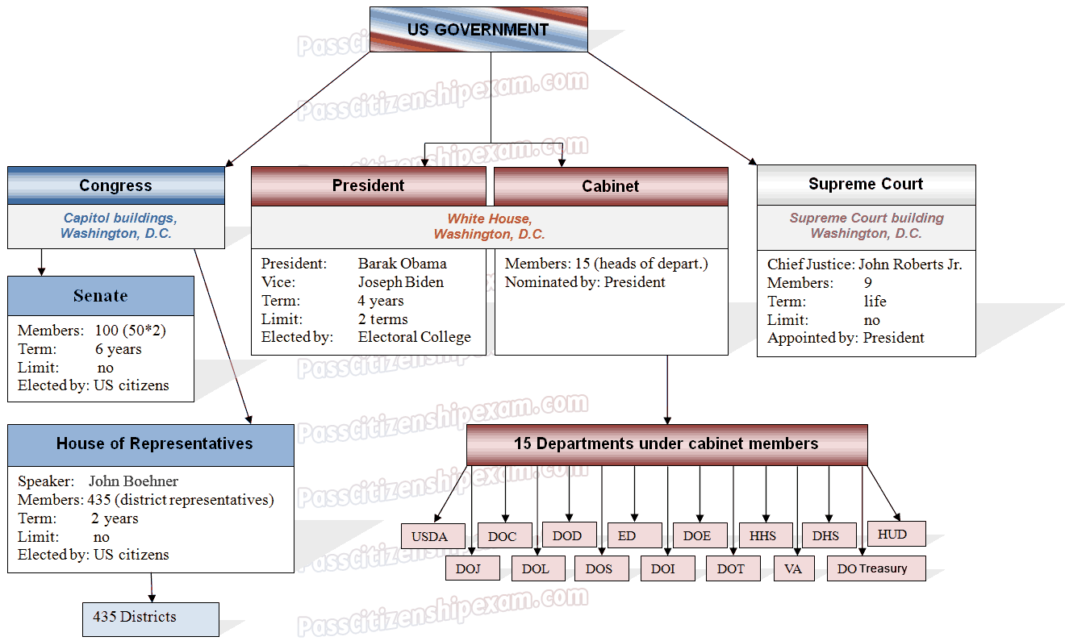
Executive Branch
President: Barack Obama
Vice: Joseph Biden
Term: 4 Years
Limit: 2 years
Elected by: Electoral College
Members: 15 (Secretary or other head of each department)
Nominated by: President
Executive Office of the President:
NSC, USTR, OMB, NEC, etc.
Executive Office of the President:
NSC, USTR, OMB, NEC, etc.

Slide 7
The Congress, President and USTR
In 1934, U.S. Congress delegated to President (POTUS) authority to negotiate free trade agreements (FTAs).
President delegated to Office of the U.S. Trade Representative (USTR) the development, coordination and negotiation of U.S. international trade, commodity, and investment policies, negotiations, enforcement.
USTR is in the Executive Office of the President (EOP)
National Security Council (NSC) and National Economic Council (NEC) help POTUS oversee trade policy.

Slide 8
USTR =
The USTR is an Ambassador and Cabinet member who serves as President’s principal trade advisor, negotiator, spokesperson, and representative to WTO.
Through an interagency structure (TPRG & TPSC), USTR coordinates trade policy within the Administration*
USTR frames issues for POTUS decisions through consultations with Congress and standing Congressional Committees (SFC & HWM)
USTR consults with 28 appointed private-sector industry & special-interest advisory groups: ACTPN, APAC, 16 ITACs, IGPAC, LAC, TEPAC, TACA: 700 people
USTR’s newer role: compliance and enforcement

Slide 9
Department of Commerce
Mission: make U.S. businesses more innovative at home and more competitive internationally
Multiple bureaus & functions to, e.g., promote U.S. exports, monitor weather, manage fish, assist small businesses, collect data, take the census, etc.
Key trade-related functions:
Antidumping and countervailing duty investigations
Sectoral and functional support for USTR trade negotiations
Trade compliance monitoring (along with USTR)
Management of industry trade advisory committees
Export promotion and trade missions – NEI²

Slide 10
Other Agencies with Trade Responsibilities
Department of State (DOS)
Department of Agriculture (USDA)
Department of Treasury (Treas)
Department of Labor (DOL)
Ex-Officio: U.S. International Trade Commission (USITC or ITC): an independent agency
Administers U.S. trade laws within its mandate
“Dataweb” with U.S. export and import data
U.S. Harmonized Tariff Schedule (HTSUS)
Completes independent trade studies on FTAs, regulatory decisions, tariffs, U.S. competitiveness
Staff are industry experts

Slide 11
(Opaque) Interagency Review Process: Led by USTR
19 agencies provide advice to USTR in developing and coordinating implementation of U.S. trade policy; operates by reaching consensus on issues/decisions:
90 Subcommittees (e.g., Special 301, GSP) recommend to:
Trade Policy Staff Committee (AUSTR/DAS): if consensus on the decision - is final determination; if not goes to…
Trade Policy Review Group (Deputy USTR/Deputy or Assistant Secretary): if consensus, is final decision; if not, goes to…
Principals (Cabinet): if consensus, is final decision; if not goes to the…
President for THE final decision

Slide 12
President’s Trade Agenda - 2015
Explaining why trade is good for the U.S.
High-standard, job-supporting trade agreements
Trade enforcement
Engagement with key trading partners
Trade and development
Public engagement

Slide 14
USTR Trade Initiatives
Reciprocal Free Trade Agreements (FTAs): w/20 countries
Trade and Investment Framework Agreements (TIFAs): 47 TIFAs (and many other agreements)
Unilateral Preferences: Generalized System of Preferences (GSP), African Growth & Opportunity Act (AGOA), Caribbean Basin Initiative (CBI), Haiti/HOPE
Bilateral Investment Treaties (BITs): with 42 countries
Compliance monitoring and enforcement (ITEC)
WTO Agreements (TISA, Envmtal Goods, Doha)

Slide 15
Enforcement Mechanisms
WTO cases (China, Indonesia, European Union…)
FTA consultations and dispute settlement
CAFTA Enforcement Mechanisms: IPR, Worker Rights, Environmental Protection, Transparency, Investor Protections
Columbian (FTA) Labor Action Plan
Special 301 (Intellectual Property Rights (IPR) Review): Notorious Markets; Priority Watch List (PWL) 10; Watch List (WL) 27 (including Guatemala)
Other Trade Barrier Reports: 1) all Foreign Trade Barriers (NTE); 2) Technical Barriers to Trade (TBT); 3) Sanitary and Phyto-Sanitary Measures (SPS).
Mandatory GSP Criteria: Worker Rights, IPR, Investor Protections

Slide 16
FTA Negotiation Process
Country requests FTA; need support by business & labor
Interagency consensus to launch negotiations (assess FTA impacts, likelihood of success, etc.)
President notifies Congress of intent to negotiate: 90 days
During wait, USITC report; Hill & ITAC consultations begin
Negotiations occur in rounds between the parties
TPA-mandated consultations with House and Senate Advisory Groups from committees with jurisdiction
Administration must publish updates specific to how objectives are being met in the negotiations
Chief Transparency Officer (Timothy Reif) to advise USTR on transparency with Congress and public

Slide 17
FTA Approval Process
President notifies Congress: intent to sign (90 days)
Environmental reviews, advisory committee reports, USITC FTA economic impact report
Once FTA negotiations end, attorneys do legal text scrub, Presidential announcement, and signing
During course of FTA negotiation and especially after signing, Embassies, private sector associations, NGOs lobby Congress
Getting FTAs through Congress: “little to do with agreement substance and everything to do with U.S. politics”
Fast track or TPA: up/down vote approval authority, must occur within 90 days of submission
Notes:
Mock markups
Implementation bills introduced in House and Senate
Ways and Means reports bill (45 days); House must vote (15 days)
Finance Committee must report bill (15 days); Senate must vote (15 days)

Slide 18
President Obama’s Actions
Since being in office, President Obama has:
Pushed through approval of three FTAs (Panama, Colombia, Korea)
Re-launched Trans Pacific Partnership (TPP) and added partners – Malaysia, Mexico, Canada, Japan – conclude?
Launched the Trans Atlantic Trade and Investment Partnership Agreement (TTIP) between the U.S. and EU
Launched Trade in Services Agreement (TISA) talks
GSP, AGOA, Haiti preferences renewed (some for 10 yrs)
Trade Promotion Authority passed
Emphasis on enforcement and access for U.S. business
WTO Trade Facilitation Agreement
WTO Environmental Goods Agreement
Notes:
Fix title font stuff

Slide 19
President’s Trade Agenda Stretches Available USTR Resources
Trans Pacific Partnership Agreement (TPP)
Transatlantic Trade and Investment Partnership (TTIP)
Trade in Services Agreement (TISA)
Implementing Bali Trade Facilitation Agreement (TF)
Implementing Information Technology Agreement (ITA)
Launching Environmental Goods Agreement (EGA)
Participating in Strategic and Economic Dialogue (S&ED) and Joint Commission on Commerce and Trade (JCCT) with China
Inform U.S. public that FTAs strengthen U.S. businesses & jobs through expanding exports (for TPP passage)

Slide 20
Trade Capacity Building
TCB -- focus on ensuring compliance with commitments
TCB=AfT=Technical Assistance
TCB requests to USG most persuasive when a country is seeking to meet standards of an agreement to which they are a signatory (e.g., IPR enforcement, trade in services, ITA, government procurement, etc.)
FTAs and AGOA/Haiti preferences have TCB – AGOA not “forever” – USTR Amb. Froman
TF Agreement has a TCB element
Leading the effort: USAID, Customs (DHHS), State, Trade Development Agency (TDA), and Commercial Law Development Program (CLDP)

Slide 21
U.S. Trade Policy and Doing Business Tips
Ask questions, even if you know the answer; you’ll find out more than the answer you sought
Meet your deadlines and written agreements
We often are not “relationship” people
Keep current: e-newsletters (agencies and companies), Facebook, LinkedIn, Twitter, blogs
Know which agency or person really is in charge or makes the decision (despite others’ claims)
What you see is not always what it is, so….
Keep asking questions and solicit opinions

Slide 22
Web Resources
Glossary of Acronyms: http://www.ustr.gov/about-us/trade-toolbox/glossary-trade-terms
U.S. Trade Representative’s e-newsletter
World Trade Online; Washington Trade Daily; Politico Pro (trade)
Who is importing from your country: Panjiva, etc.
U.S. International Trade Commission: www.usitc.gov
Congressional Research Service: https://opencrs.com (also: J.F. Hornbeck paper on “Congress & Trade,” April 2011)
Guide to U.S. Government: http://bensguide.gpo.gov/
Other: sandlertrade.com, wita.org

Slide 23
Where to Look For…
Trade policy – ustr.gov; trade.gov
Import regulations – cbp.gov
Import data: http://dataweb.usitc.gov/scripts/tariff_current.asp
Tariff schedules, trade studies - USITC.gov; census.gov;
Legislation -- thomas.loc.gov;
Submitting comments -- regs.gov
Federal notices -- federalregister.gov
Can’t attend a hearing but want to listen - hearings are webcast – go to Committee websites

Slide 24
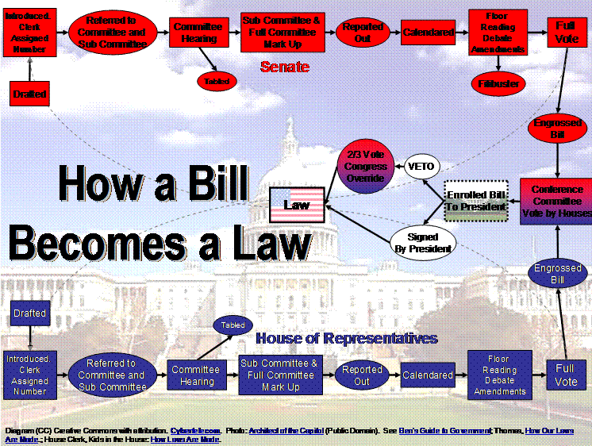

Slide 25
Committees of the House of Representatives
Agriculture: FARM BILL
Appropriations
Armed Services
Budget
Education and the Workforce
Energy and Commerce
Ethics
Financial Services
Foreign Affairs: NOT TRADE
Homeland Security
House Administration
Intelligence
Judiciary
Natural Resources
Oversight and Government Reform
Rules
Science, Space, and Technology
Small Business
Transportation and Infrastructure
Veterans' Affairs
Ways and Means: TRADE: GSP, TPA, FTAs, Normal Trade Relations (NTR), Customs, Miscellaneous Tariff Bill

Slide 26
Senate Committees
Aging
Agriculture, Nutrition, and Forestry : FARM BILL
Appropriations
Armed Services
Banking, Housing, and Urban Affairs
Budget
Commerce, Science, and Transportation
Energy and Natural Resources
Environment and Public Works
Ethics
Finance: TRADE: GSP, TPA, NTR, MISCELLANEOUS TARIFF BILL, CUSTOMS REAUTH.
Foreign Relations: NOT TRADE
Health, Education, Labor, and Pensions
Homeland Security and Governmental Affairs
Indian Affairs
Intelligence
Judiciary
Rules and Administration
Small Business and Entrepreneurship
Veterans' Affairs

Slide 27
TPA Summary
Authorizes President to enter into trade agreements with foreign countries for reduction or elimination of tariff or nontariff barriers before July 1, 2018, or before July 1, 2021, if trade authorities procedures are extended to implementing bills (congressional approval)
Authorizes President to proclaim necessary or appropriate modifications or continuation of existing duty, continue existing duty-free or excise treatment, or additional duties
Subjects trade agreements to congressional oversight and approval, consultations, and access to information requirements.
Requires the convening each Congress of the House and the Senate Advisory Groups on Negotiations to consult with and advise the United States Trade Representative (USTR) regarding the formulation of specific objectives, negotiating strategies and positions, the development of the applicable trade agreement, and compliance and enforcement of the negotiated commitments under the trade agreement.
Amends the Trade Act of 1974 to establish within the Office of the USTR the position of Chief Transparency Officer to consult with Congress on transparency policy, coordinate transparency in trade negotiations, engage and assist the public, and advise the USTR
Prescribes procedures for resolutions of disapproval in the House and the Senate before the President enters into any trade agreement.
Declares that trade authorities procedures shall not apply to any implementing bill submitted with respect to a trade agreement: a) if both chambers of Congress agree by a certain deadline to a procedural disapproval resolution for lack of notice or consultations, and b) with a country which does not fully comply and is not making significant efforts to comply with minimum standards for elimination of human trafficking ("tier 3" country).
Prescribes requirements for the treatment of trade agreements entered into under the auspices of the WTO or with the Trans-Pacific Partnership countries or the European Union, which result from negotiations commenced before enactment of this Act.

Slide 28
Thank you!
Notes:
Question title?

